Slide 1

Grab Eat – Online Food Ordering System
Mihir Shrivas (20104081)
Bhushan Patil (20104094)
Mayur Shinde (20104062)
Project Guide
Prof. Neha Deshmukh

Slide 2
Contents
Introduction
Objectives
Scope
Literature Survey
Proposed System
Project Outcomes
Use Case/DFD
Technology Stack
Suggestions in Review-1
Result and Discussion
Conclusion and Future Scope
References

Slide 3

What is Grab Eat ?

Slide 4
Introduction
Grab Eat is an online food ordering and delivery platform.
Grab Eat uses - Demand & Delivery strategy.
This application connects with a broad range of local restaurants for online food delivery.
It’s a pre-fabricated food delivery solution, encompassed with significant features and can be built using recent technologies.

Slide 5
Problem Identified :
The challenge of physical ordering of food encountered by the existing system serves as a major drawback to the realization of efficiency & customers satisfaction.
The existing system wants the user to store contacts and menus of their local restaurants in order to place a takeaway or delivery order.
Customers have to wait in long queues before placing their orders especially during peak hours.
Solution Proposed:
With this application, users does not have to wait for the order to be prepared and stand in long waiting queue in the restaurant.
User can browse through various restaurants, food types, etc.
In this way, user can enjoy the peace and leisure time at home with lavish cooked food.

Slide 6
Objectives
The primary objective is to implement a real time application on database for online ordering system.
To make ordering food online, easier and faster process anytime-anywhere.
To concentrate on taking orders, streamlining the orders to a specified restaurant.
To provide users with options of restaurants and foods which they didn’t know existed.

Slide 7
Scope
Can be used to order food.
Can be used to browse menus of different restaurants.
Can be used to avail various offers.
Can be used to compared prices of similar foods.
Can be used to place multiple orders at the same time.

Slide 8
Literature Survey.
Given below are the research papers used for our analysis this application considering various approaches.
In paper[1] ,along with customer feedback for a restaurant a design and execution of wireless food ordering system was carried out. It enables restaurant owners to setup the system in wireless environment and update menu presentations easily. Smart phone has been integrated in the customizable wireless food ordering system with real- time customer feedback implementation to facilitate real- time communication between restaurant owners and customers.
In Paper [2], the research work aims to automate the food ordering process in restaurant and also improve the dining experience of customers. Design implementation of food ordering system for restaurants were discuss in this paper. This system implements wireless data access to servers. The android application on user’s mobile will have all the menu details .Kitchen and cashier receive the order details from the customer mobile wirelessly. These order details are updated in the central database. The restaurant owner can manage the menu modifications easily.
In Paper [3],the purpose of the study was the application is based on user’s requirement . All issues related to all user which are included in this system are developed by this system. If people know how to operate android smart phone wide variety of people can use the application. This system will solve the various issues related to Mess service. To help and solve important problems of people implementation of Online Food Ordering system is done. It can be concluded that, based on the application: Orders are made easily by this system; Information needed in making order to customer is provided by the system. Receiving orders and modifying its data is possible through the application and it also helps admin in controlling all the Food system.

Slide 9
Proposed System
Features & Functionality
Feature 1: Easy Registration and Sign up.
Feature 2: Online Payment.
Feature 3: Check order history.
Feature 4: Place multiple orders.
Feature 5: Cancel an order.

Slide 10
Outcome of the project
This system will enrich the customer experience by making the process of ordering food a lot easier.
This system will make its delivery service a viable option for everyday food needs
This application enable users to select their food item through which user can redirect to the restaurant page directly..

Slide 11
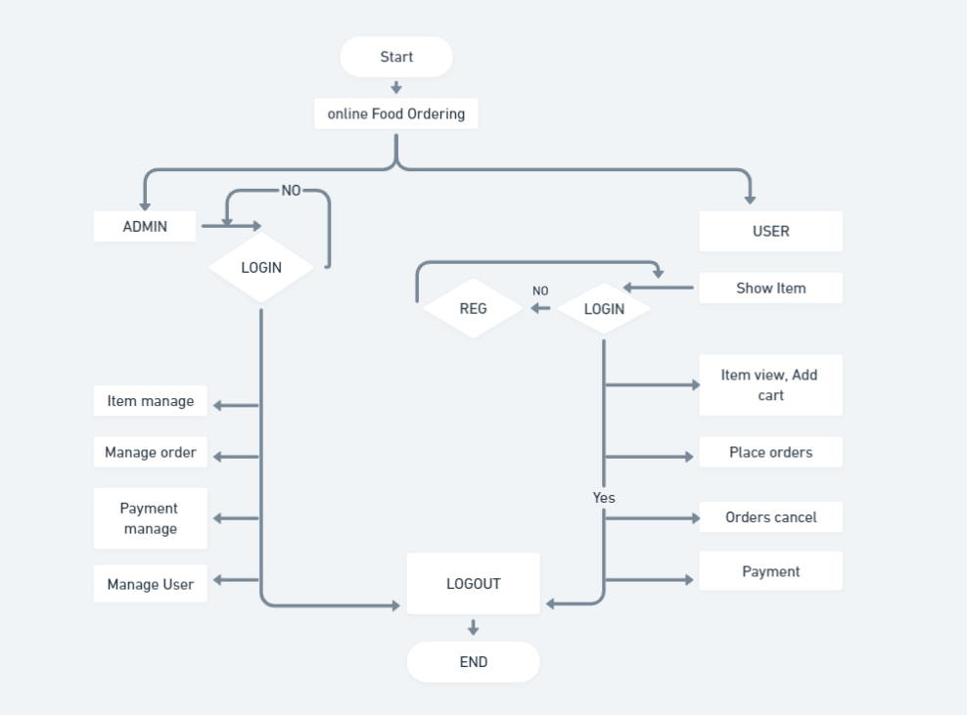
Flow Chart

Slide 12
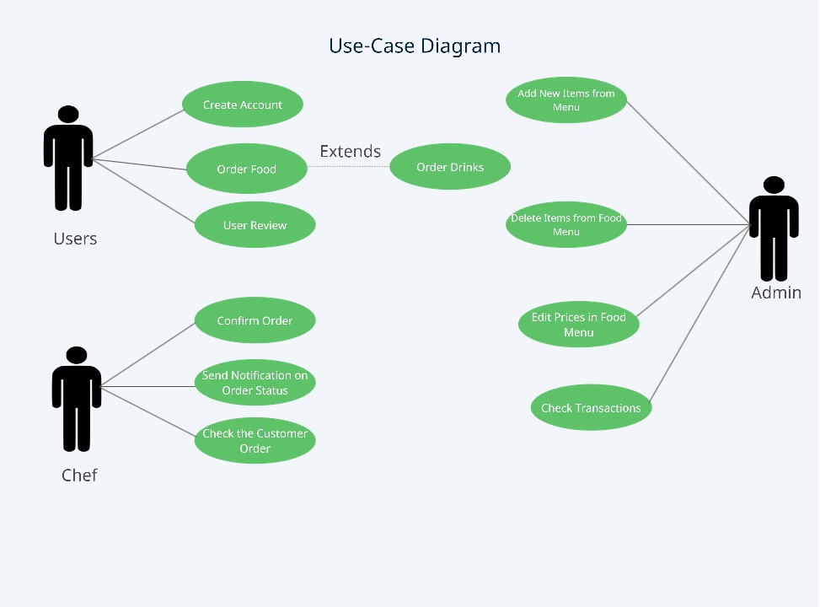
Use Case Diagram

Slide 13
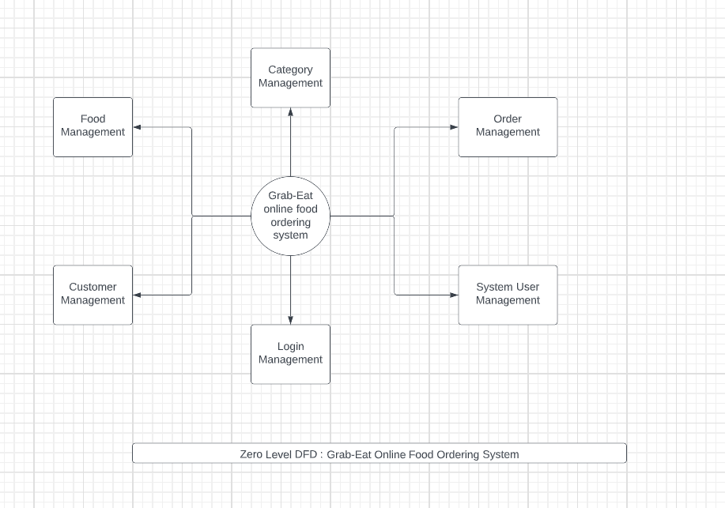
DFD Diagram
Fig1:Level (0)

Slide 14
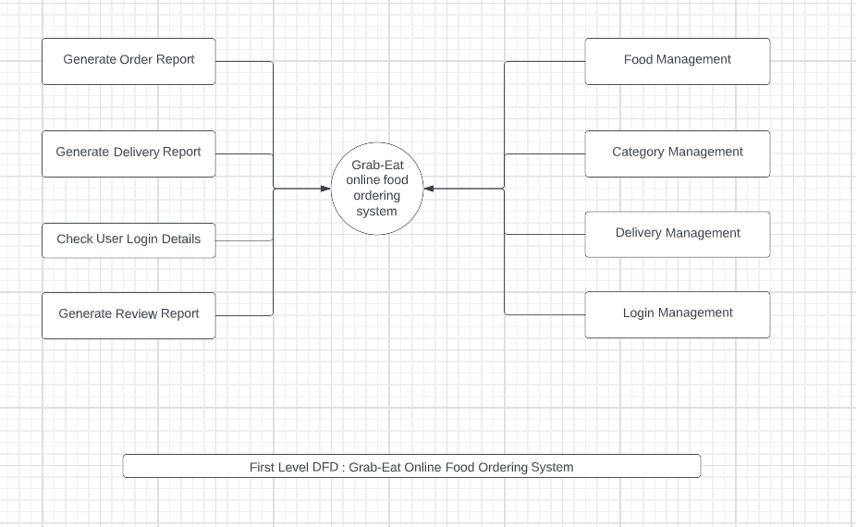
DFD Diagram
Fig2: Level(1)

Slide 15
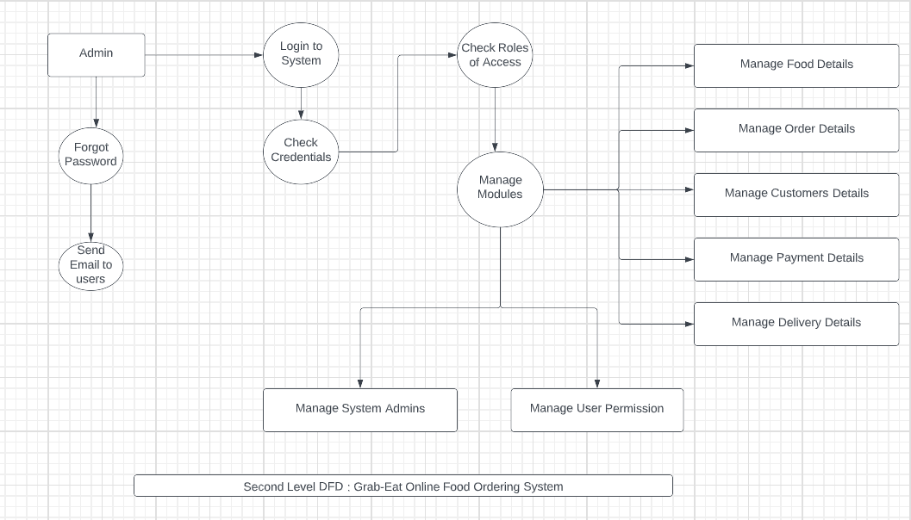
DFD Diagram
Fig3 : Level(2)

Slide 16
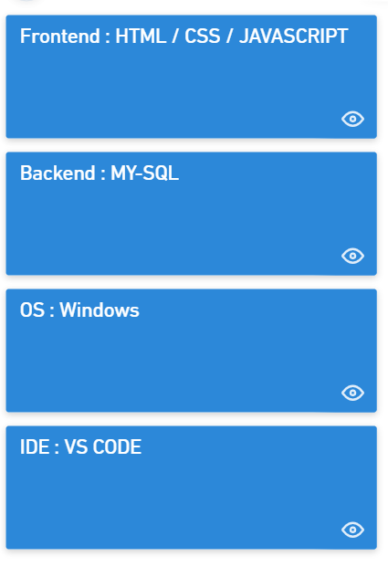

Technology Stack

Slide 17
Suggestions in Review-1
Changes in UI Design.
We have to add more scope related to our web application.
Project was fully static , make it dynamic .
Google Map API fetch.

Slide 18
Result and discussion
Following are the results that one can draw from this application:
People can easily order the food using this application.
This application will help in reduction of labour cost involved and also reduces the space requires to set up cafeterias in the restricted area.
The users can avoid the long queues at the counter, with a reasonable speed of execution and maximum output.

Slide 19
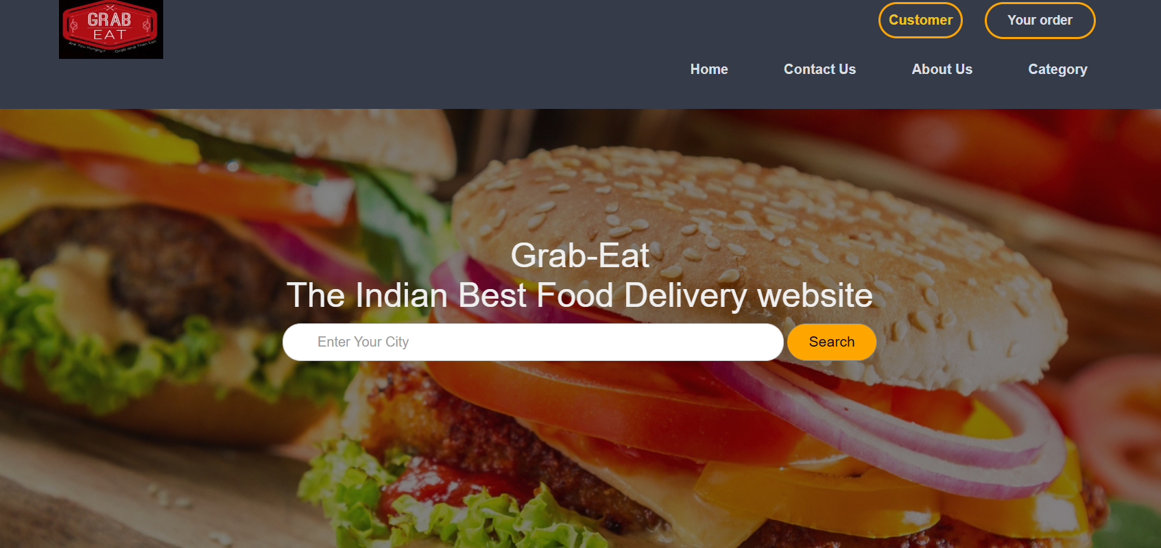
Discussion

Slide 20
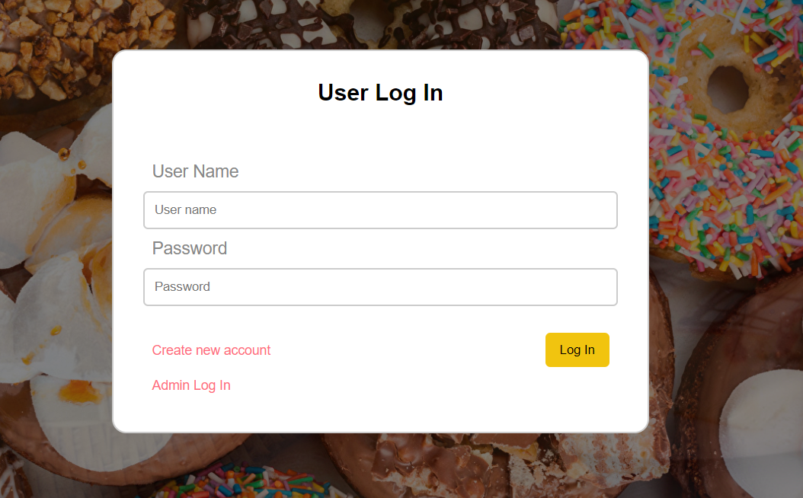
Discussion

Slide 21
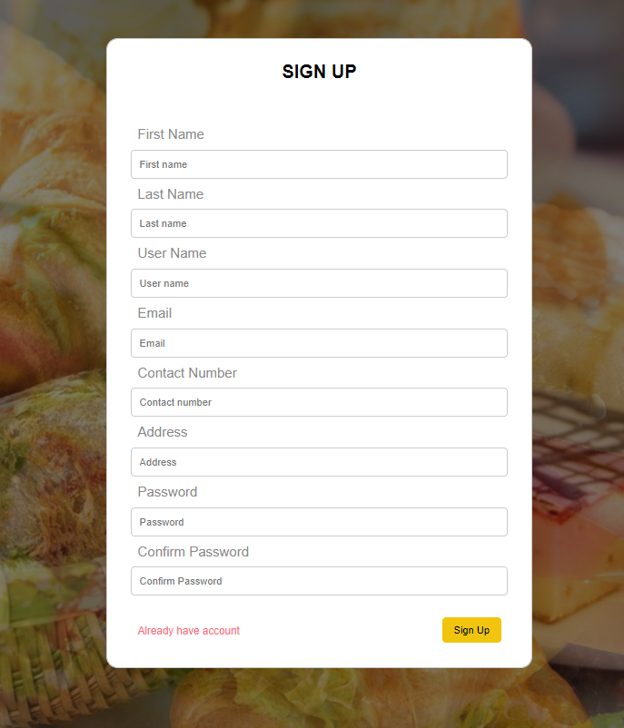
Discussion

Slide 22
Conclusion and Future Scope.
This Grab-Eat online food ordering system is developed where the customers can make an order for the food and avoid the hassles of waiting for the order to be taken by the waiter. Using this application, the end users register online, read the Category/ E-menu card and select the food from the e-menu card to order food online. Once the customer selects the required food item the user will redirect to the best restaurant to order their foods from the selected food. This application nullifies the need of a waiter or reduces the workload of the waiter. The advantage is that in a crowded restaurant there will be chances that the waiters are overloaded with orders and they are unable to meet the requirements of the customer in a satisfactory manner. Therefore by using this application, the users can directly place their order online.

Slide 23
THANK YOU.

